Slide 1

MICRON – HF WASTEWATER TREAMENT
SIMULATION & BENCH TESTING – Dec 2021
Siva Kumar Kota/Chun Yew
Hiep Le/Sankar

Slide 2
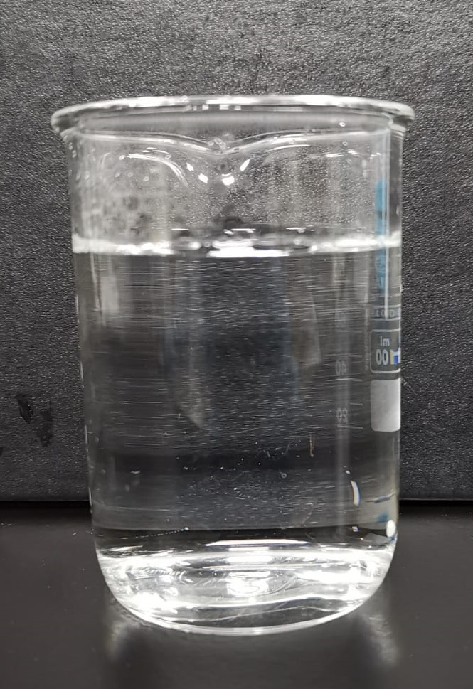
Action item 3: Preparation of Synthetic Combined NF RO Reject Solution (with pH adjustment)
Preferred chemicals | Required quantity for 1 Liter solution (gram)
NH4Cl | 0.210
NaCl | 0.064
CaCl2 | 0.049
HF | 2.986
H3PO4 | 0.367
SiH2O3 | 0.138
H2SO4 | 0.362
Elements | Desired concentration (ppm) | Calculated concentration based on added chemicals (ppm) | Concentration based on in-house measurement (ppm)
pH | 3.5 | - | 3.5
Conductivity | - | - | 6,375 µS/cm
TDS | - | - | 3,394
NH4 | 70.8 | 70.8 | 65.8
F | 2,835 | 2,835 | 2,928
SO4 | 355 | 355 | 345
PO4 | 356 | 356 | 366
Cl | 209 | 209 | 211
Na | 2,790 | 24.99 | 500
Ca | 17.7 | 17.7 | 11.1
Si | 49.5 | 49.5 | 47.6

Slide 3
Jar testing Procedure
To each testing jar, pour in 1L of wastewater sample
To each jar, dose in 7000/7500/8000 mg/L of Ca(OH)2 and rapid mix for 30s
Slow mix for 30 min, measure pH every 10 min
Dose 1mg/L for each of the SNF polymer (anionic) in each jar and further slower mix (30 rpm) for 30 min. Measure pH every 20 min
Stop mixing and leave the solids to settle over 60 min
Observe sludge settling and measure sludge height every 5 min (if applicable)
Measure turbidity of supernatant and collect the sludge
For the jar with the lowest supernatant turbidity reading, filter out the supernatant through 0.45 um filter and send for analysis and collect the sludge generated
For the sludge collected, filter out using 1.5 µm filter. Collect the sludge, dry sample for XRD analysis. Meanwhile, dissolve a pre-determined amount of collected sludge in acid and send for analysis

Slide 4
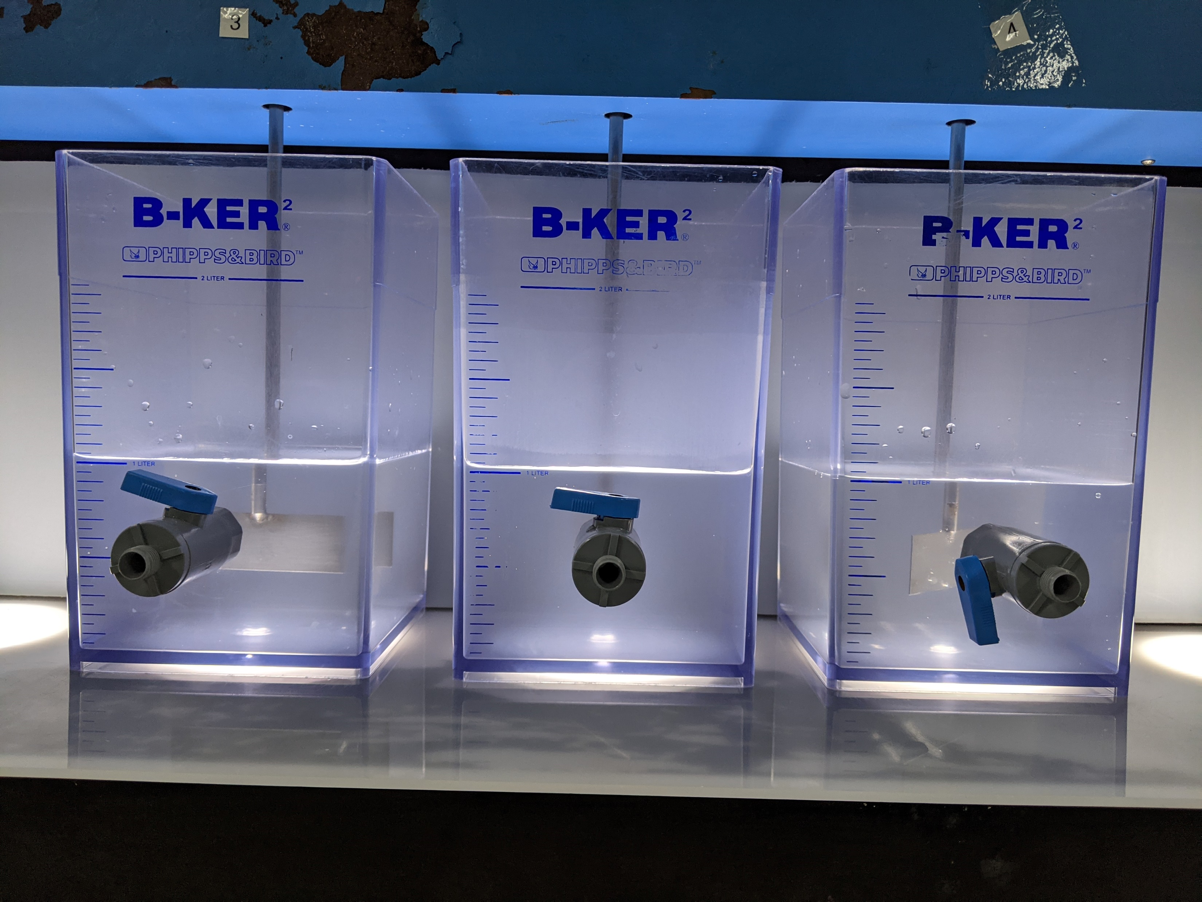
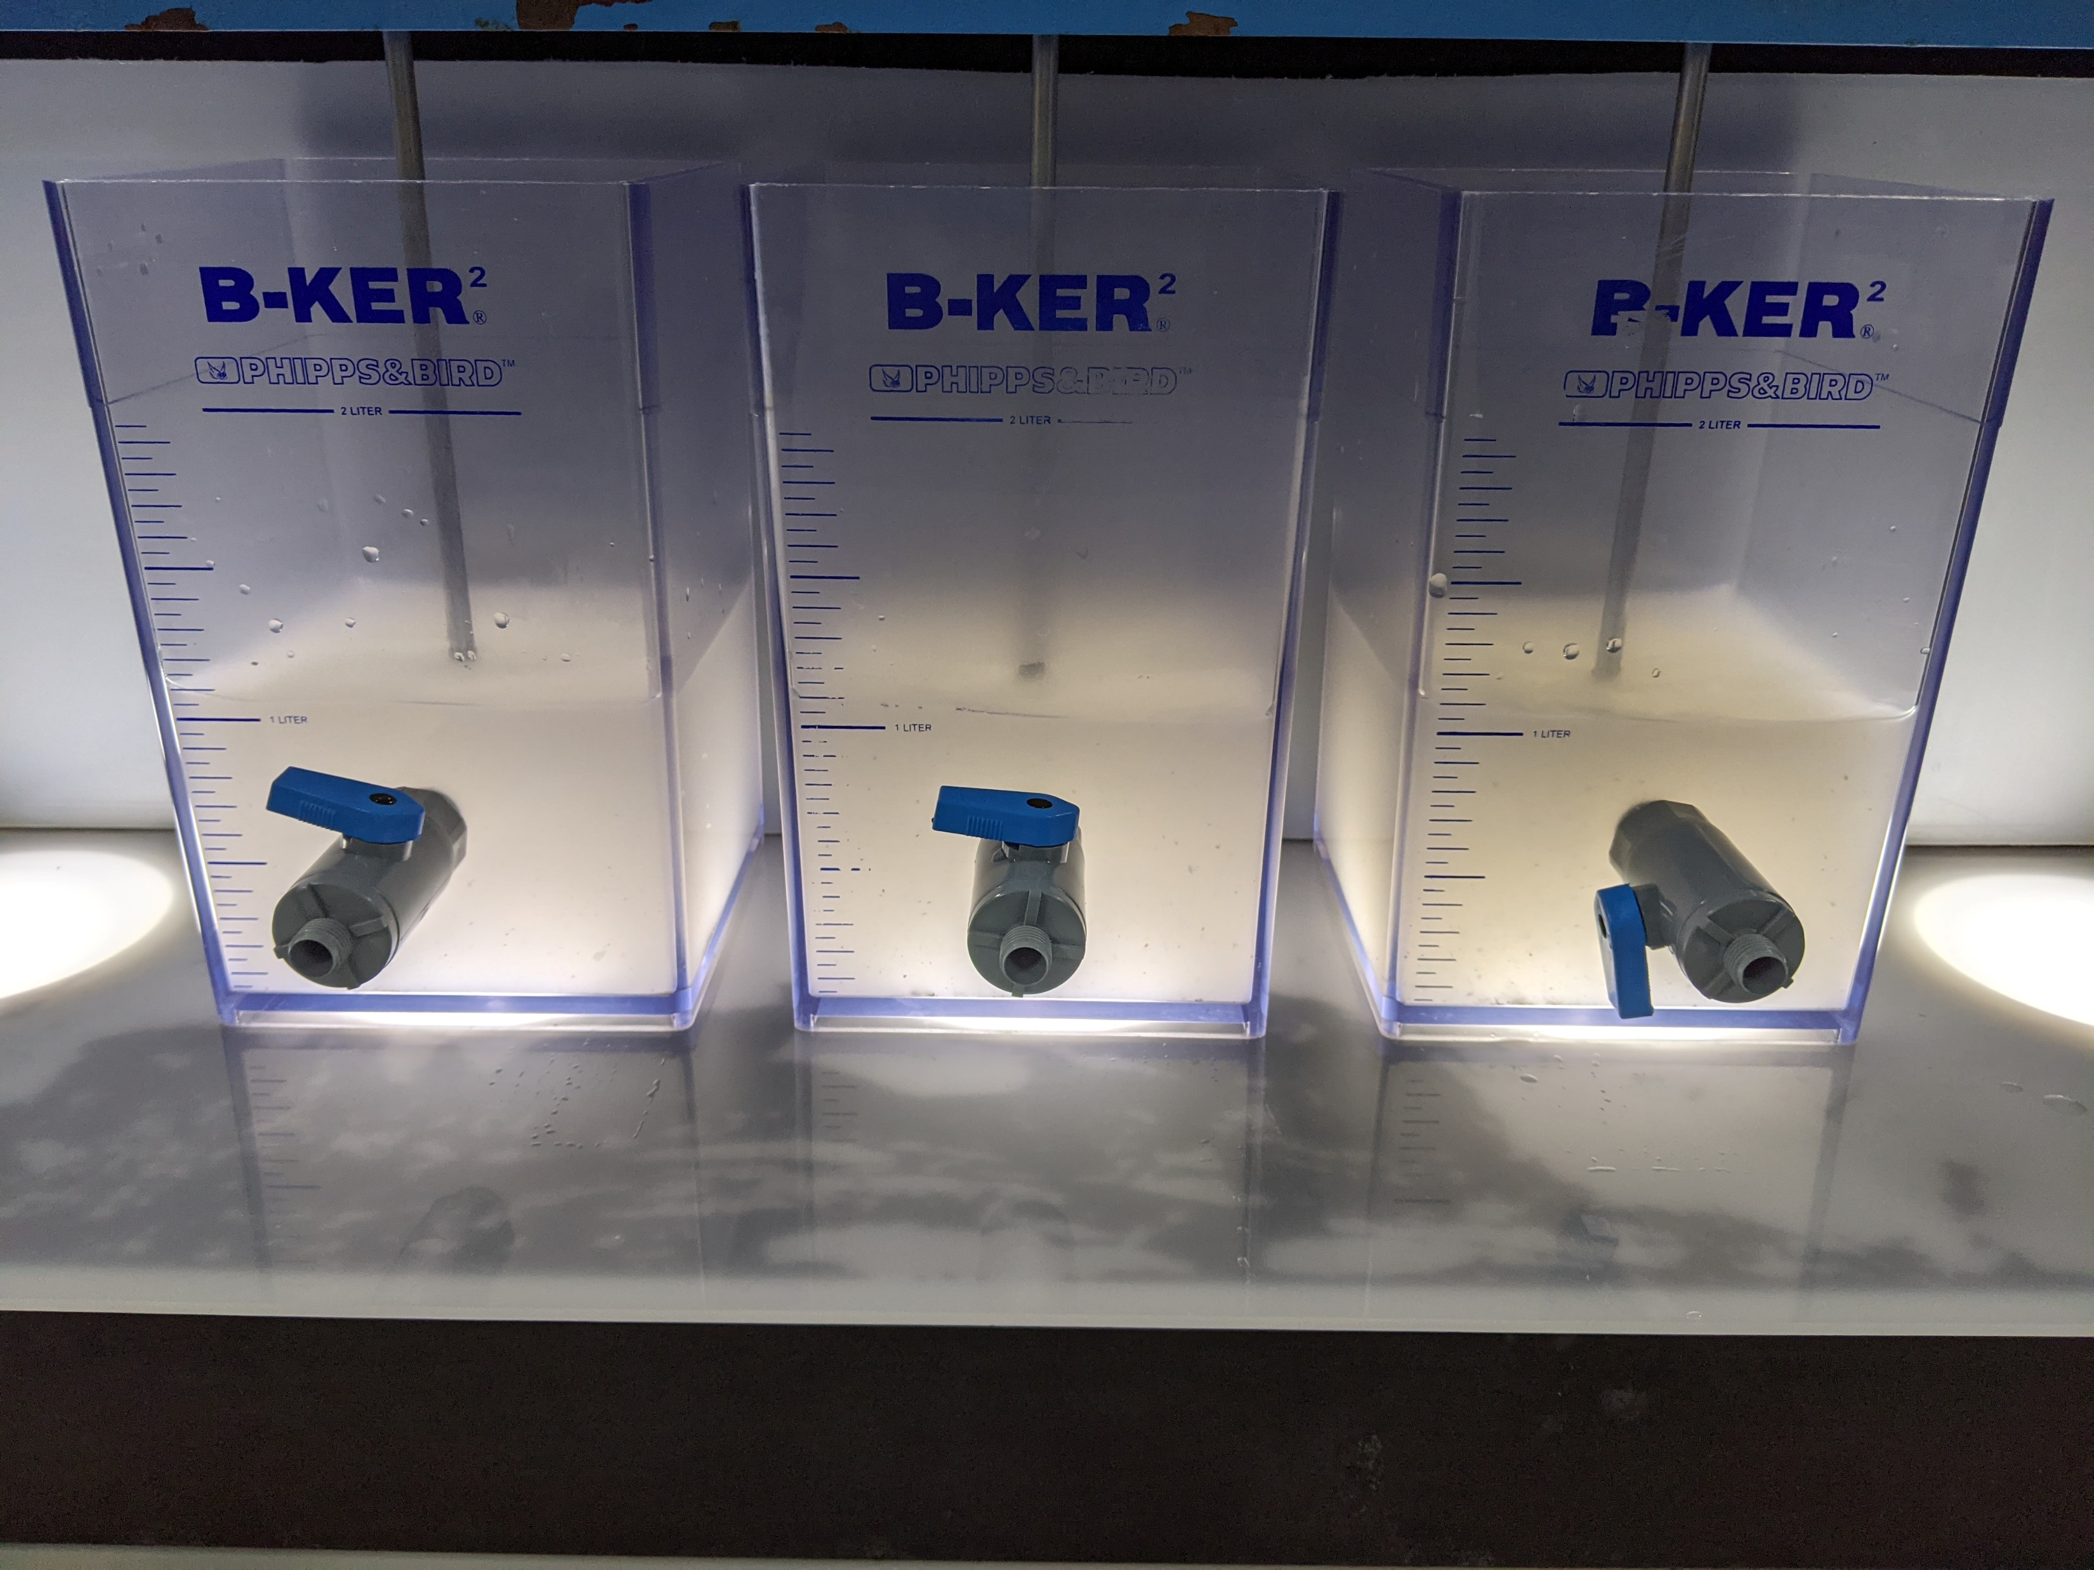
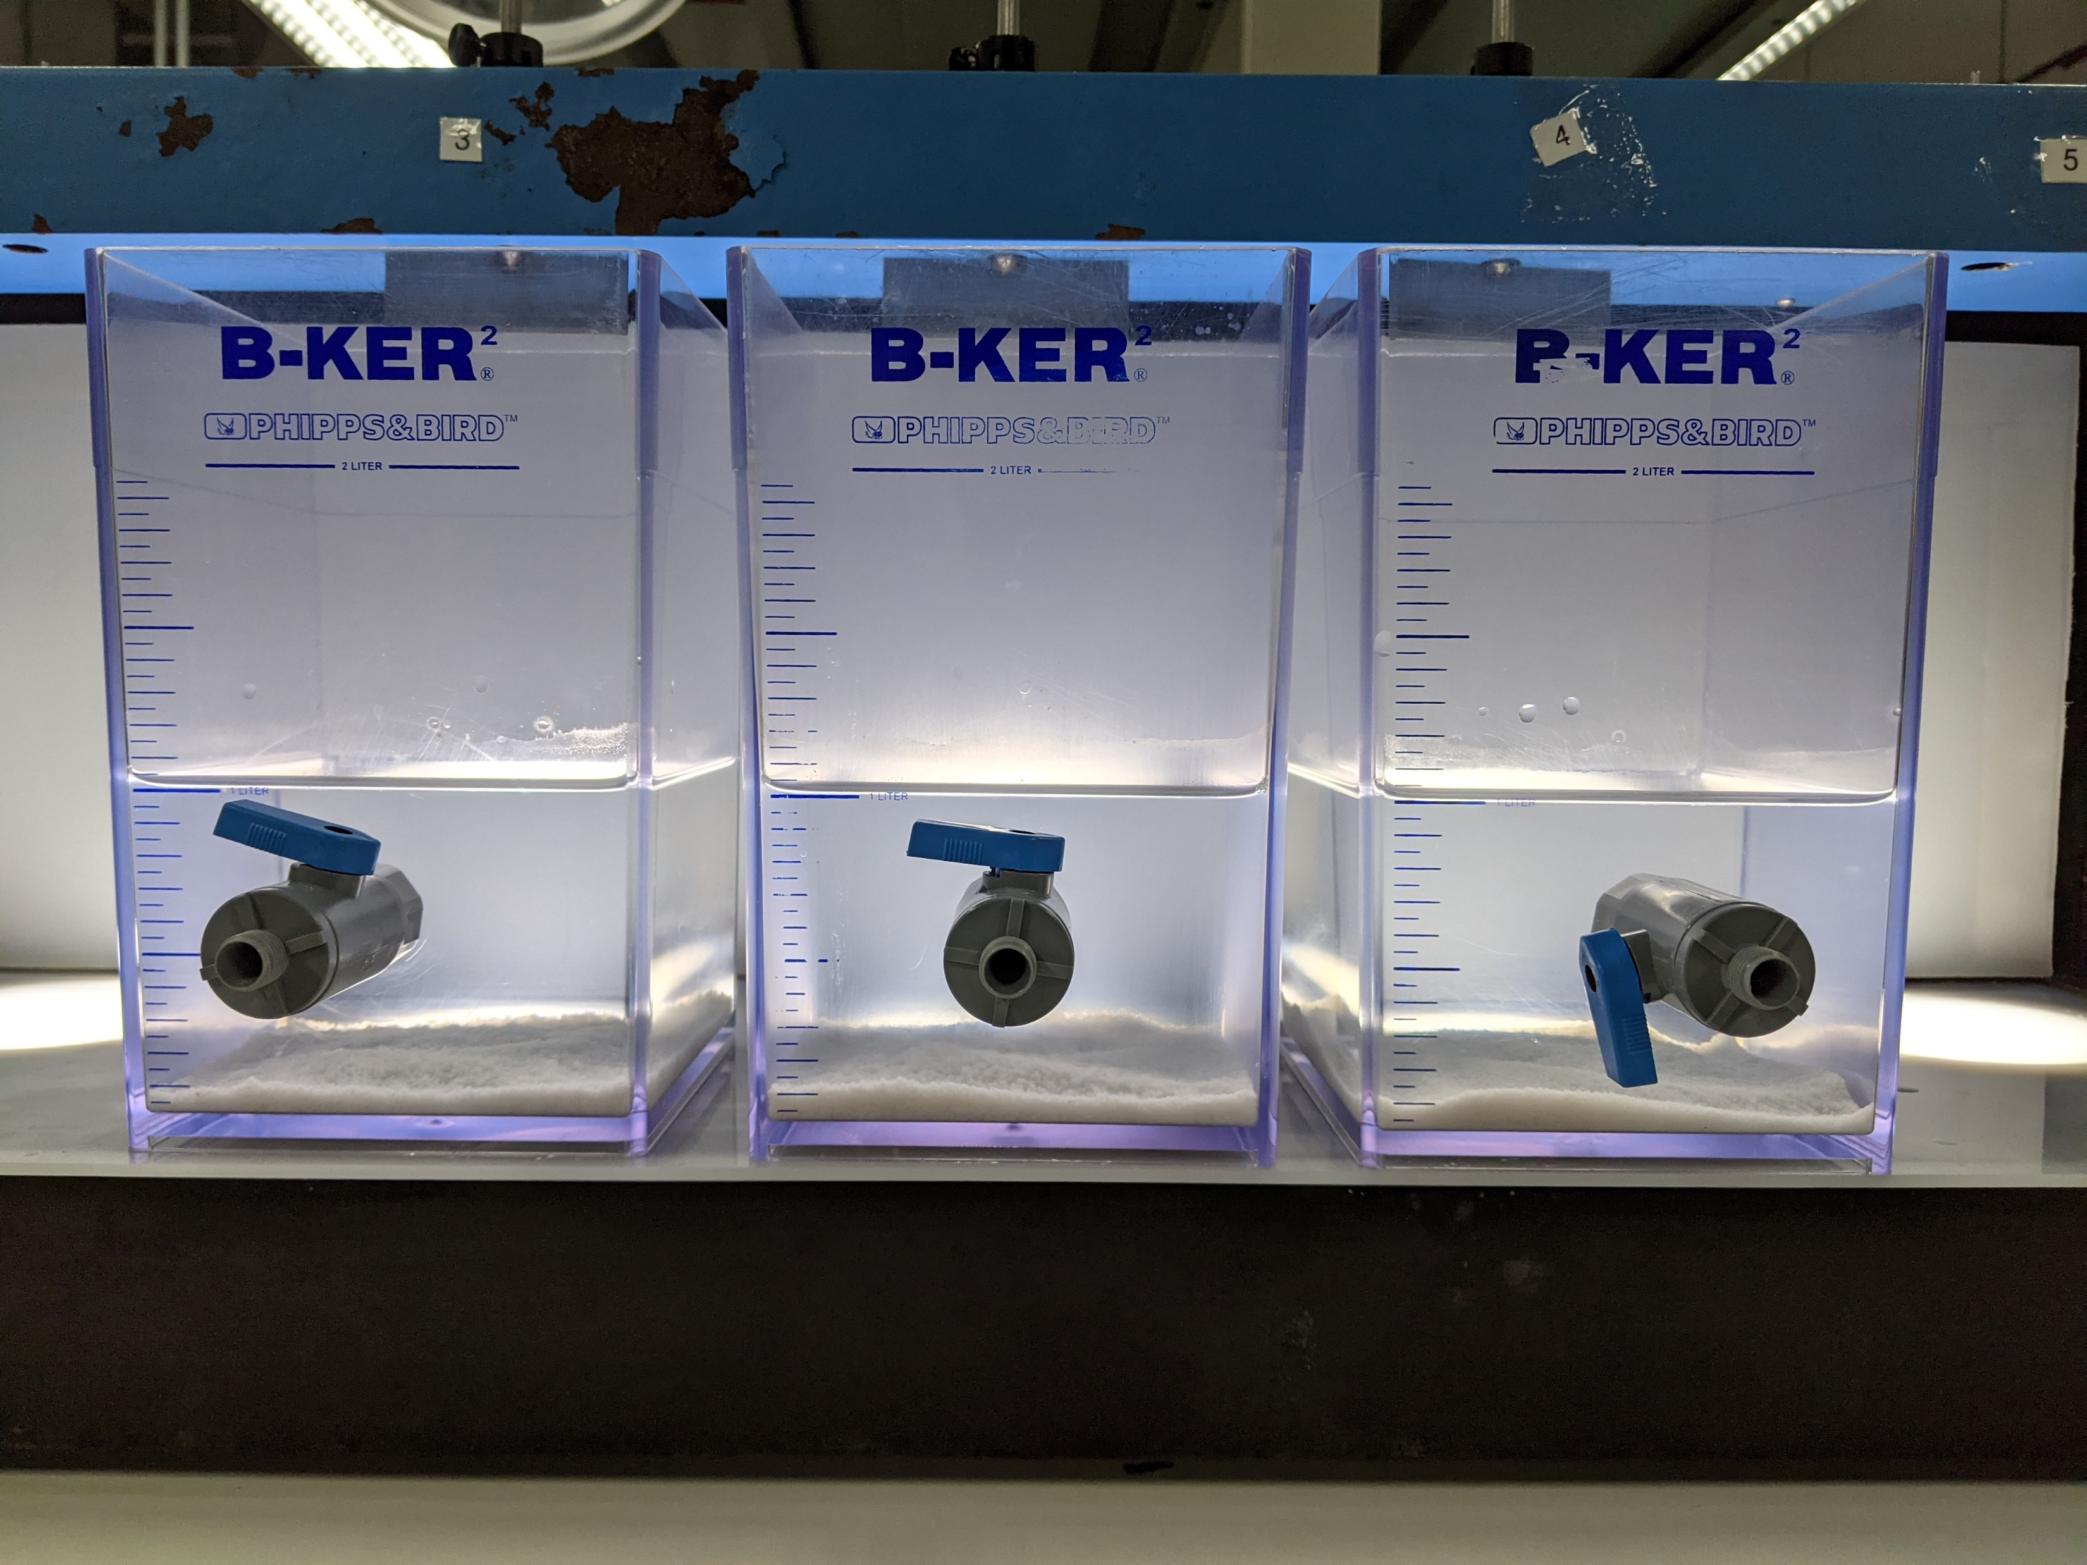
Action item 3: Jar testing of Synthetic Combined NF RO Reject (with pH adjustment) – Testing 1
Synthetic combined reject solution in different jars
Synthetic combined reject solution with added lime at different dosages (7000, 7500, 8000 ppm)
Solution with added flocculant (Flopam AN 934 SH). Precipitates clumped and settled after the addition of flocculant.

Slide 5
Action item 3: Jar testing of Synthetic Combined NF RO Reject (with pH adjustment) – Testing 1
Chemical precipitation with Ca(OH)2
Jar | Lime dosage (ppm) | pH
 |  | t = 15 min | t = 20 min | t = 30 min
1 | 7000 | 4.82 | 6.49 | 8.97
2 | 7500 | 9.98 | 11.08 | 11.46
3 | 8000 | 11.69 | 11.81 | 11.93
Coagulation and flocculation with 1 mg/L anionic polymer
Jar | Lime dosage (ppm) | pH |  |  | Polymer used
 |  | t = 10 min | t = 20 min | t = 30 min
1 | 7000 | 9.03 | 9.23 | 9.22 | Flopam AN 934 SH
2 | 7500 | 11.45 | 11.47 | 11.43 | Flopam AN 934 SH
3 | 8000 | 12.01 | 12.05 | 12.00 | Flopam AN 934 SH

Slide 6
Jar testing of Synthetic Combined NF RO Reject

Slide 7
Jar testing of Synthetic Combined NF RO Reject (with pH adjustment) – Testing 1
Jar | Polymer added | Lime dosage (ppm) | Supernatant turbidity (NTU)
1 | Flopam AN 934 SH | 7000 | 0.39
2 | Flopam AN 934 SH | 7500 | 0.33
3 | Flopam AN 934 SH | 8000 | 1.08
Elements | Concentration based on in-house measurement (ppm) | Supernatant quality for Jar 1 | Supernatant quality for Jar 2 | Supernatant quality for Jar 3
pH | 3.5 | 9.22 | 11.43 | 12
Conductivity | 6,375 µS/cm | 2,324 µS/cm | 2,338 µS/cm | 3,115 µS/cm
TDS | 3,394 | 1,177 | 1,185 | 1,603
NH4 | 65.8 | 67.4 | 55.7 | 51.6
F | 2,928 | 210 | 137 | 60.3
SO4 | 345 | 207 | 216 | 179
PO4 | 366 | <1 | <1 | <1
Cl | 211 | 192 | 194 | 194
Na | 500 | 493 | 459 | 478
Ca | 11.1 | 1.43 | 2.58 | 9.57
Si | 47.6 | 21.7 | 1.86 | 0.308

Slide 8
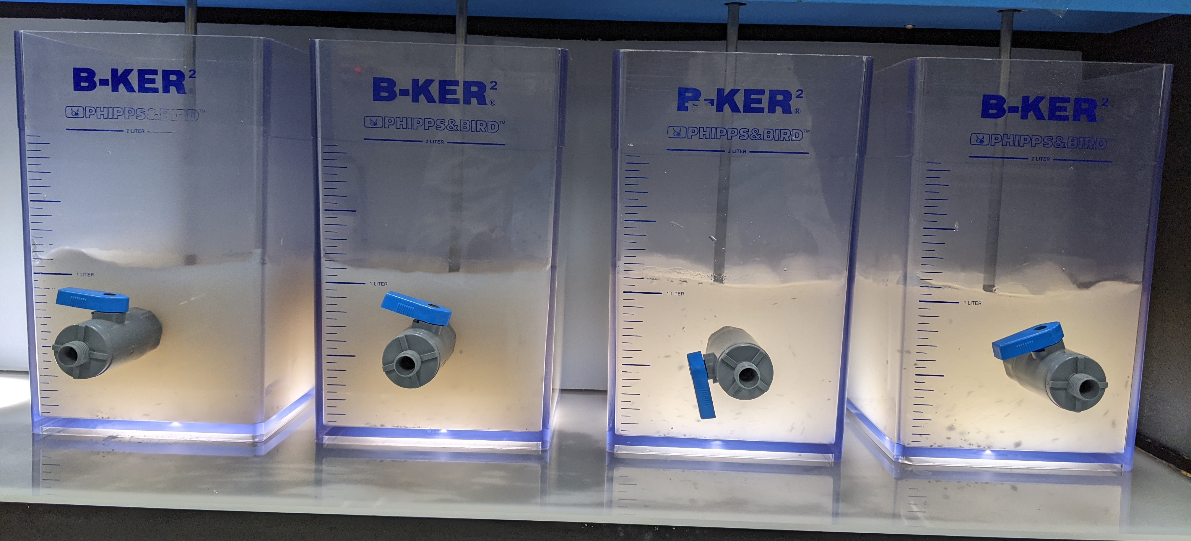
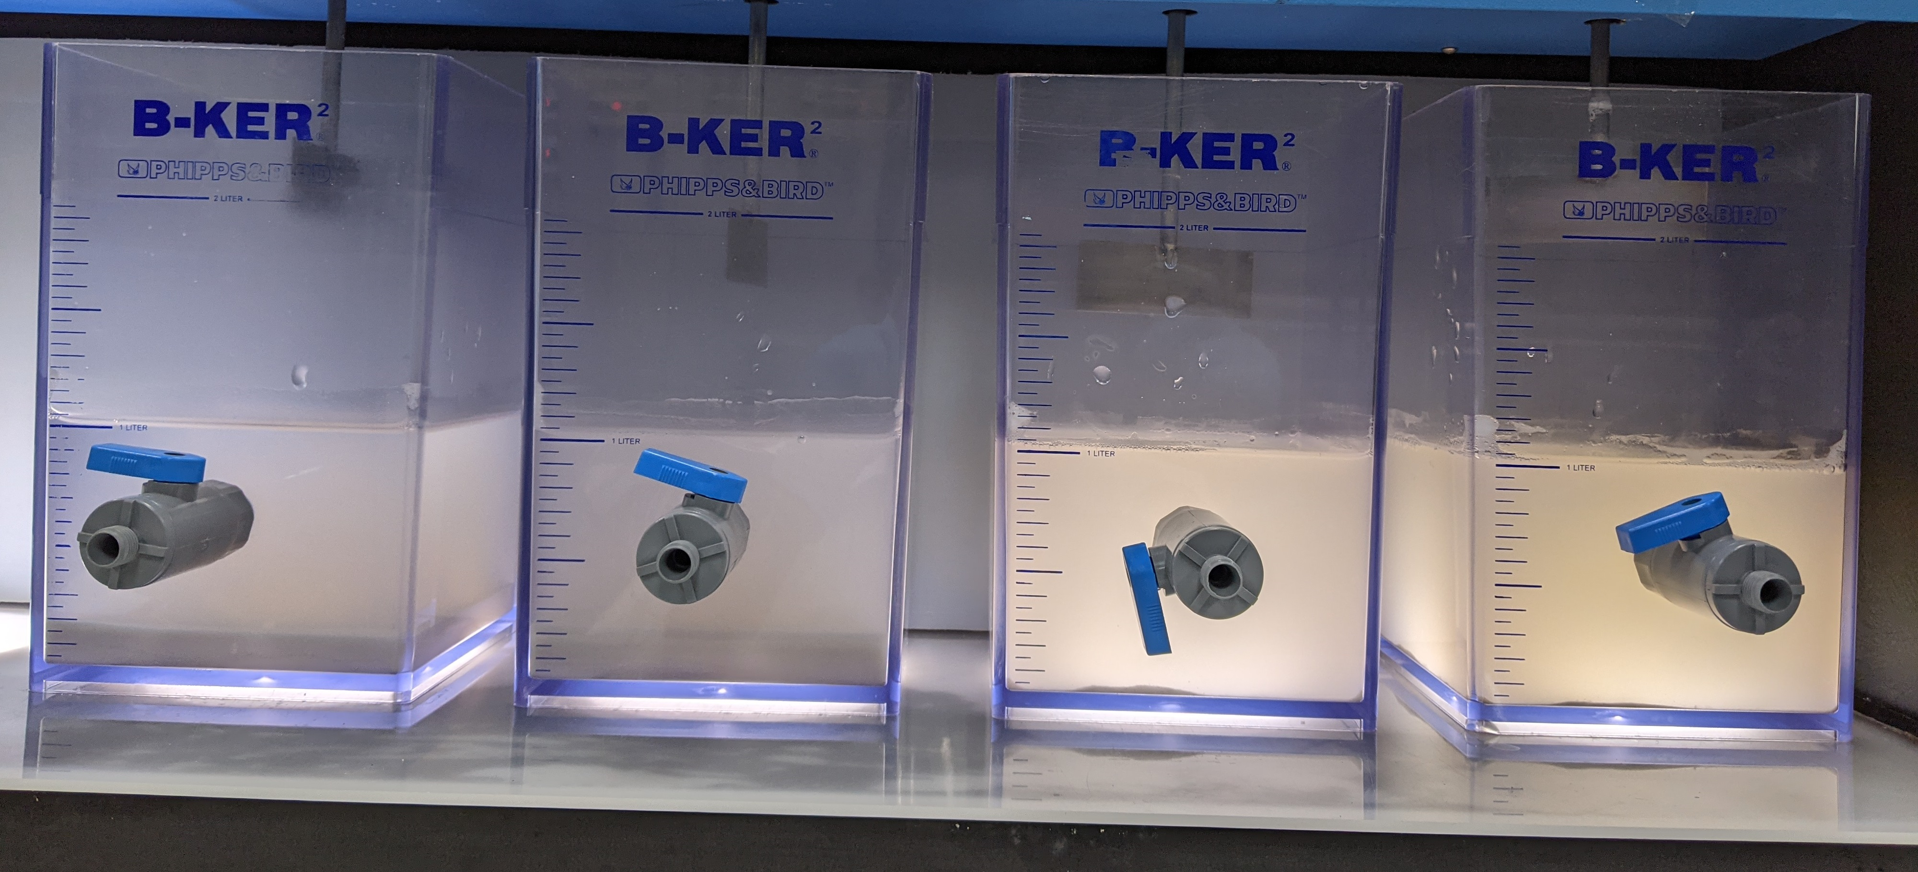
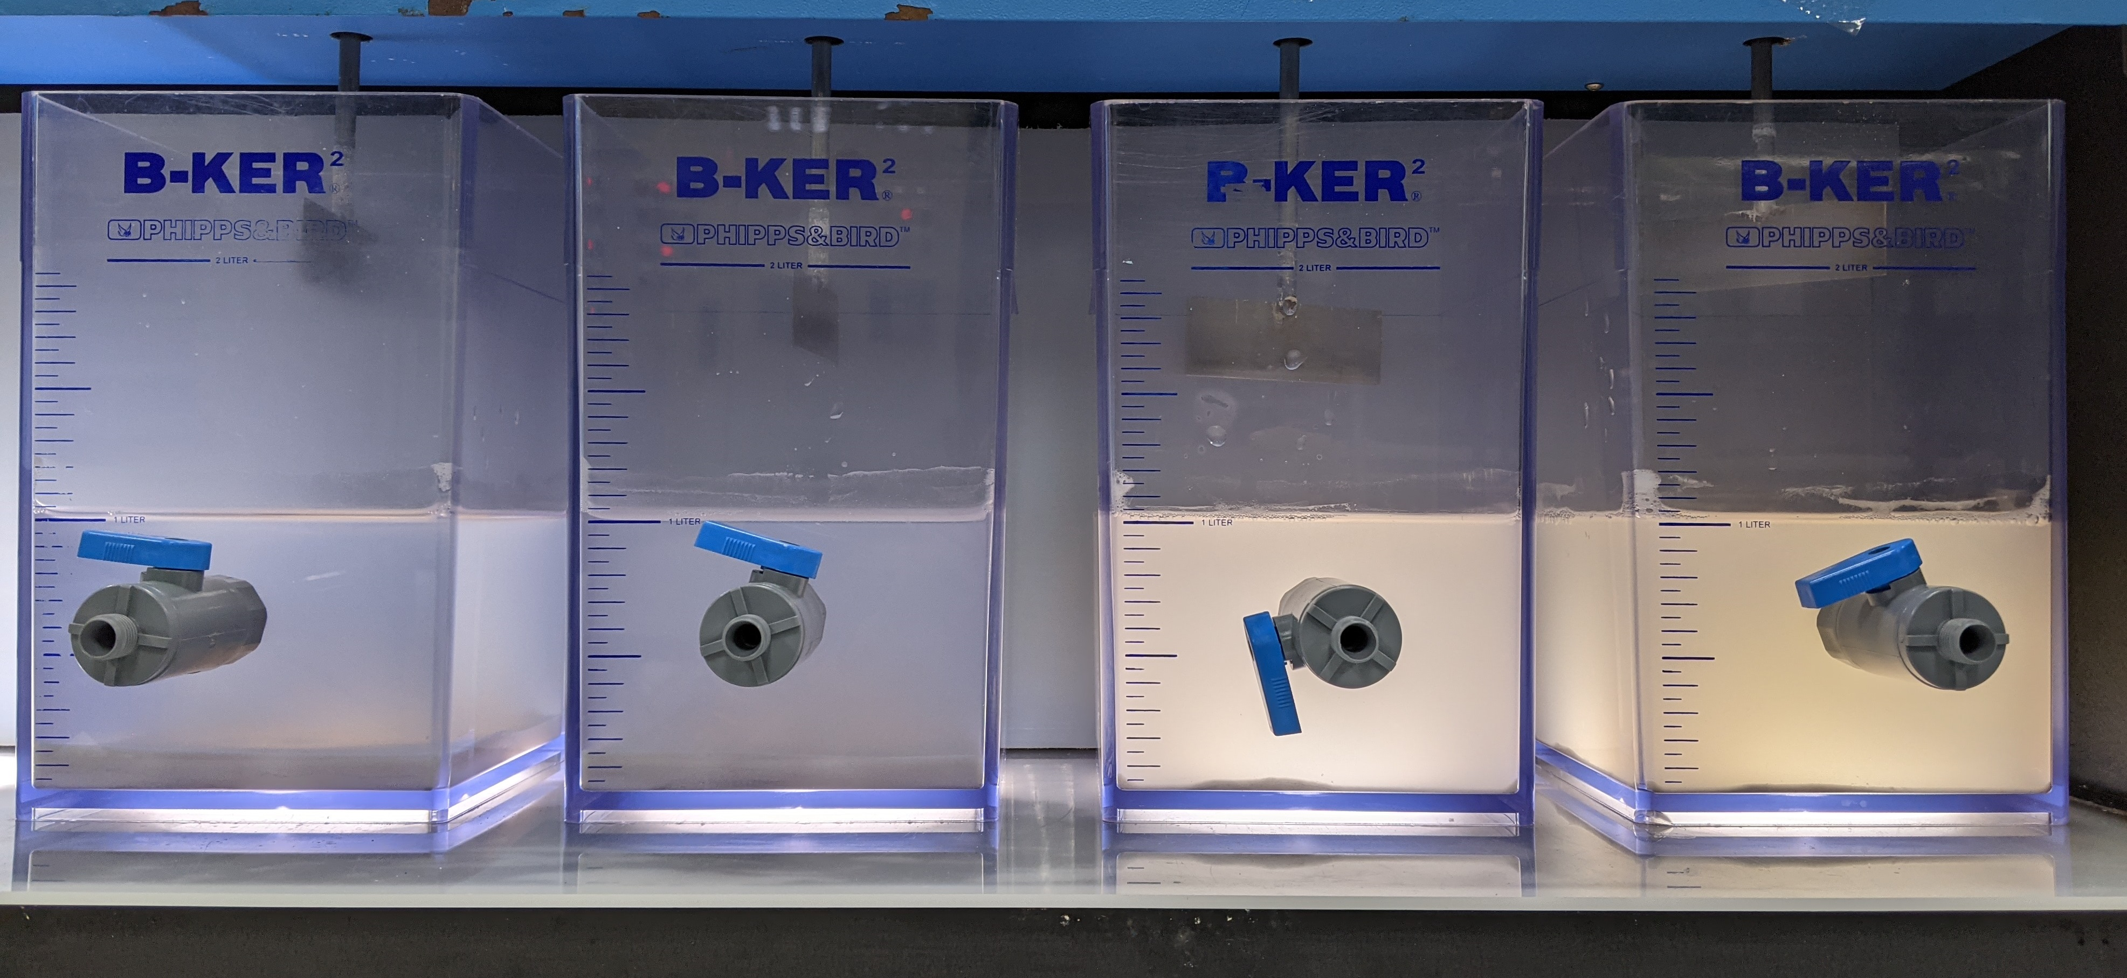
Action item 3: Jar testing of Synthetic Combined NF RO Reject (with pH adjustment) – Testing 2
Synthetic combined reject solution in different jars, with added different chemicals. Jar 1 from the left most to jar 4 in right most.
Starting of settling
End of settling

Slide 9
Action item 3: Jar testing of Synthetic Combined NF RO Reject (with pH adjustment )– Testing 2
Chemical precipitation with Ca(OH)2 (lime) and CaCl2
Jar | Chemical dosage | pH
 |  | t = 10 min | t = 20 min | t = 30 min
1 | 10,000 ppm lime | 12.52 | 12.59 | 12.62
2 | 12,000 ppm lime | 12.65 | 12.70 | 12.71
3 | 5,000 ppm lime + 5,000 ppm CaCl2 | 2.04 | 2.08 | 2.13
4 | 6,000 ppm lime + 6,000 ppm CaCl2 | 2.38 | 2.94 | 4.81
Coagulation and flocculation with 1 mg/L anionic polymer
Jar | Chemical dosage | pH |  |  | Polymer used
 |  | t = 2 min | t = 10 min | t = 30 min
1 | 10,000 ppm lime | 12.58 | 12.54 | 12.56 | Flopam AN 934 SH
2 | 12,000 ppm lime | 12.67 | 12.72 | 12.65 | Flopam AN 934 SH
3 | 5,000 ppm lime + 5,000 ppm CaCl2 | 2.13 | 2.13 | 2.09 | Flopam AN 934 SH
4 | 6,000 ppm lime + 6,000 ppm CaCl2 | 6.21 | 6.29 | 6.48 | Flopam AN 934 SH

Slide 10
Action item 3: Jar testing of Synthetic Combined NF RO Reject (with pH adjustment) – Testing 2
Jar | Polymer added | Chemicals dosage | Supernatant turbidity (NTU)
1 | Flopam AN 934 SH | 10,000 ppm lime | 20.8
2 | Flopam AN 934 SH | 12,000 ppm lime | 74.2
3 | Flopam AN 934 SH | 5,000 ppm lime + 5,000 ppm CaCl2 | 430
4 | Flopam AN 934 SH | 6,000 ppm lime + 6,000 ppm CaCl2 | 496
Elements | Concentration based on in-house measurement (ppm) | Supernatant quality for Jar 1 | Supernatant quality for Jar 2 | Supernatant quality for Jar 3 | Supernatant quality for Jar 4
pH | 3.5 | 12.56 | 12.65 | 2.09 | 6.48
Conductivity | 6,375 µS/cm | 8,233 µS/cm | 10.64 mS/cm | 11.76 mS/cm | 10.43 mS/cm
TDS | 3,394 | 4,460 | 5,867 | 6,526 | 5,745
NH4 | 65.8 | 57 | 59.4 | 68.4 | 72.6
F | 2,928 | 8.21 | 5.61 | 187 | 610
SO4 | 345 | 72.4 | 50.6 | 32 | 96.3
PO4 | 366 | <1 | <1 | 241 | 83
Cl | 211 | 191 | 164 | 2,939 | 3,548
Na | 500 | 353 | 343 | 365 | 402
Ca | 11.1 | 389 | 622 | 1,077 | 2,139
Si | 47.6 | <0.1 | <0.1 | 65.2 | 66.7

Slide 11
Action item 3: Jar testing of Synthetic Combined NF RO Reject (with pH adjustment) – Testing 3
Jar | Polymer added | Chemical's dosage | Supernatant turbidity (NTU)
1 | Flopam AN 934 SH | 8000 ppm lime + 4000 ppm CaCl2 | 56.9
2 | Flopam AN 934 SH | 8000 ppm lime + 10000 ppm CaCl2 | 226
3 | Flopam AN 934 SH | 8000 ppm lime + 6000 ppm CaCl2 | 138
4 | Flopam AN 934 SH | 8000 ppm lime + 8000 ppm CaCl2 | 162
5 | Flopam AN 934 SH | 6000 ppm lime + 4000 ppm CaCl2 | 22
Elements | Concentration based on in-house measurement (ppm) | Supernatant quality for Jar 1 | Supernatant quality for Jar 2 | Supernatant quality for Jar 3 | Supernatant quality for Jar 4 | Supernatant quality for Jar 5
pH | 3.5 | 11.96 | 11.91 | 12.03 | 11.91 | 9.8
Conductivity | 6,375 µS/cm | 8889 µS/cm | 17.23 mS/cm | 11.93 mS/cm | 14.4 mS/cm | 7756 µS/cm
TDS | 3,394 | 4844 | 9824 | 6624 | 8108 | 4180
F | 2,928 | 9.15 | 13 | 29.1 | 14 | 14.2
SO4 | 345 | 116 | 117 | 114 | 114 | 106
PO4 | 366 | <1 | <1 | 3.14 | <1 | <1
Cl | 211 | TBC | TBC | TBC | TBC | 2376
Na | 500 | 440 | 496 | 440 | 434 | 429
Ca | 11.1 | 1098 | 2858 | 1738 | 2263 | 920
Si | 47.6 | 0.149 | 0.342 | 0.863 | 0.356 | 10.5

Slide 12
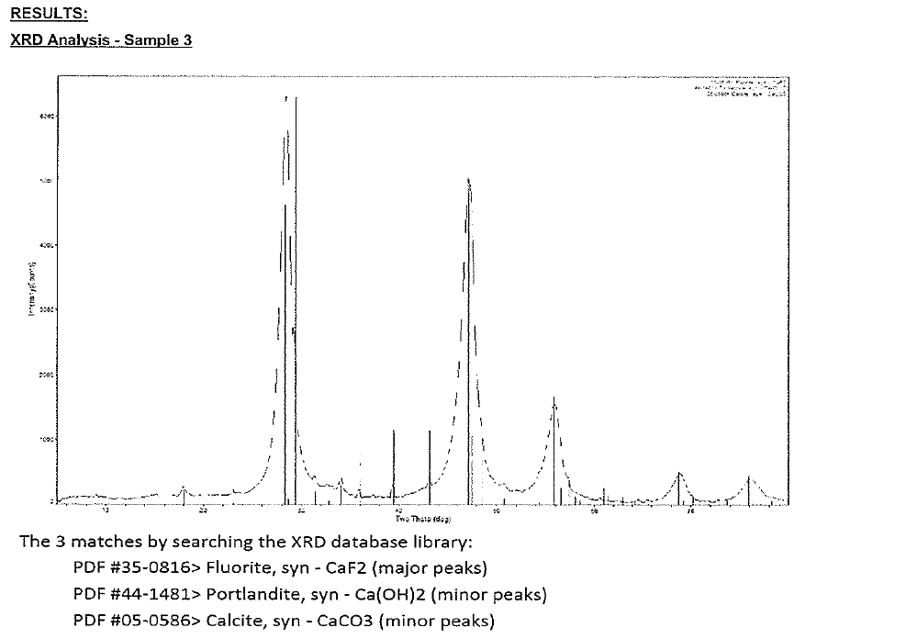
Action item 3 : XRD analysis of CaF2 sludge
Synthetic combined reject solution with added lime at 7500 PPM
Notes:
Area

Slide 13
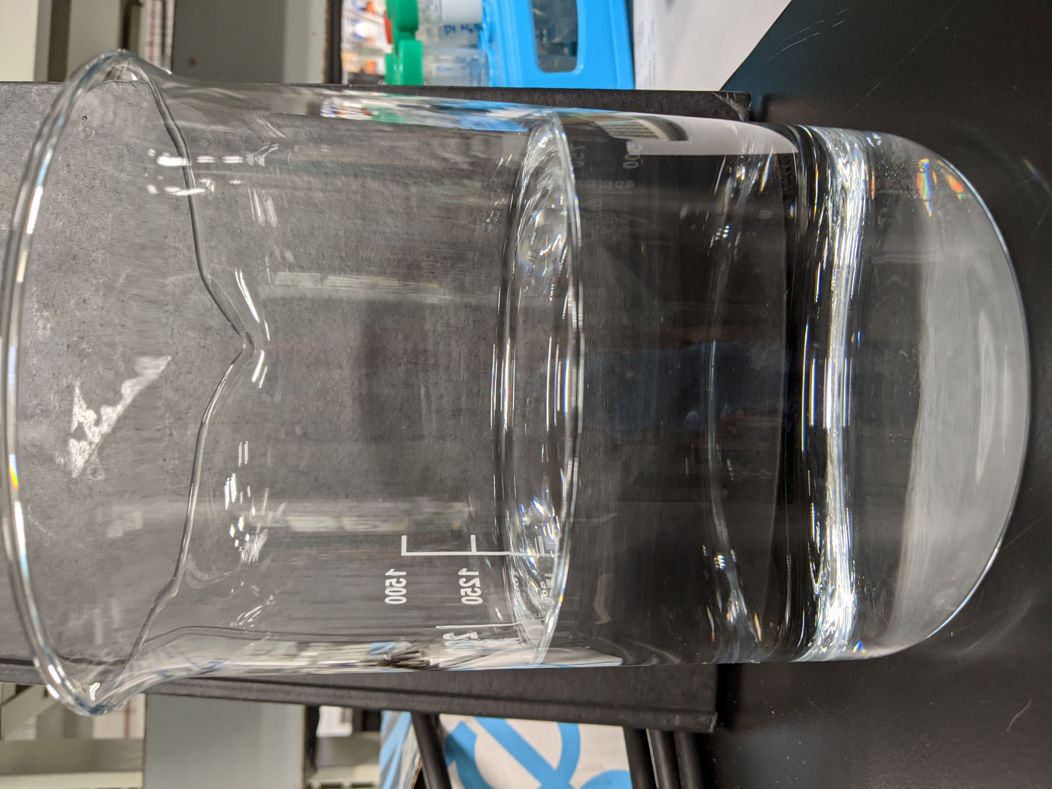
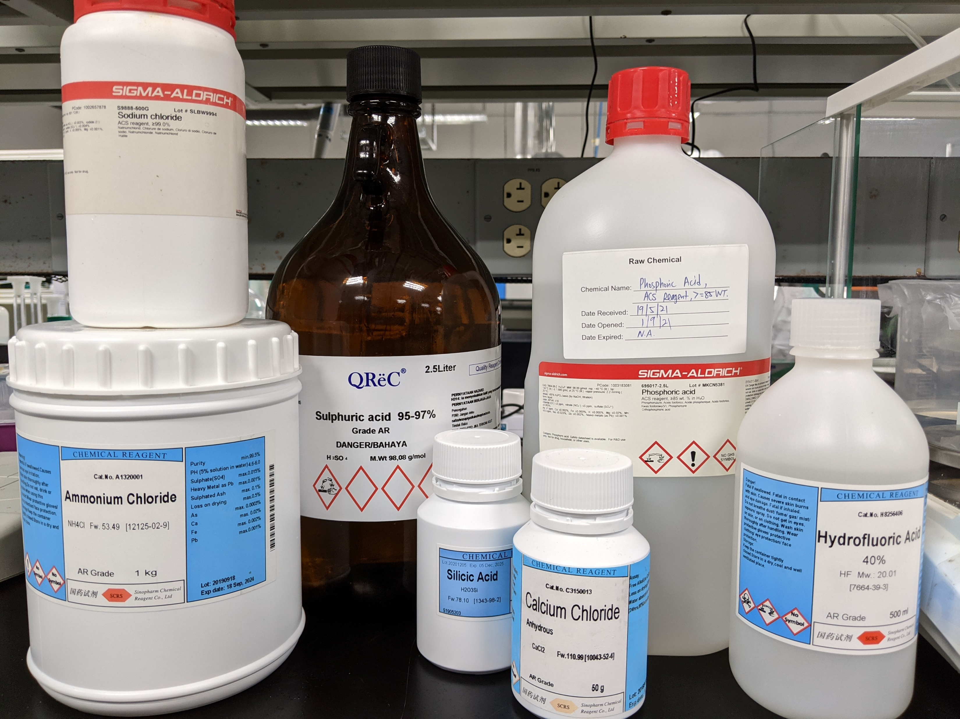
Action item 4: Preparation of Synthetic HFW+NH4F Solution (with pH adjustment)
Preferred chemicals | Required quantity for 1 Liter solution (gram)
NH4Cl | 0.059
NaCl | 0.013
CaCl2 | 0.014
HF | 0.843
H3PO4 | 0.206
SiH2O3 | 0.039
H2SO4 | 0.102
Elements | Desired concentration (ppm) | Calculated concentration based on added chemicals (ppm) | Concentration based on in-house measurement (ppm)
pH | 3.5 | - | 3.5
Conductivity | - | - | 2,481 µS/cm
TDS | - | - | 1,263
NH4 | 20 | 20 | 19.2
F | 800 | 800 | 789
SO4 | 100 | 100 | 98
PO4 | 200 | 200 | 205
Cl | 50 | 55.86 | 62.9
Na | 5 | 5 | 339
Ca | 5 | 5 | 4.05
Si | 14.02 | 14.02 | 16.2

Slide 14
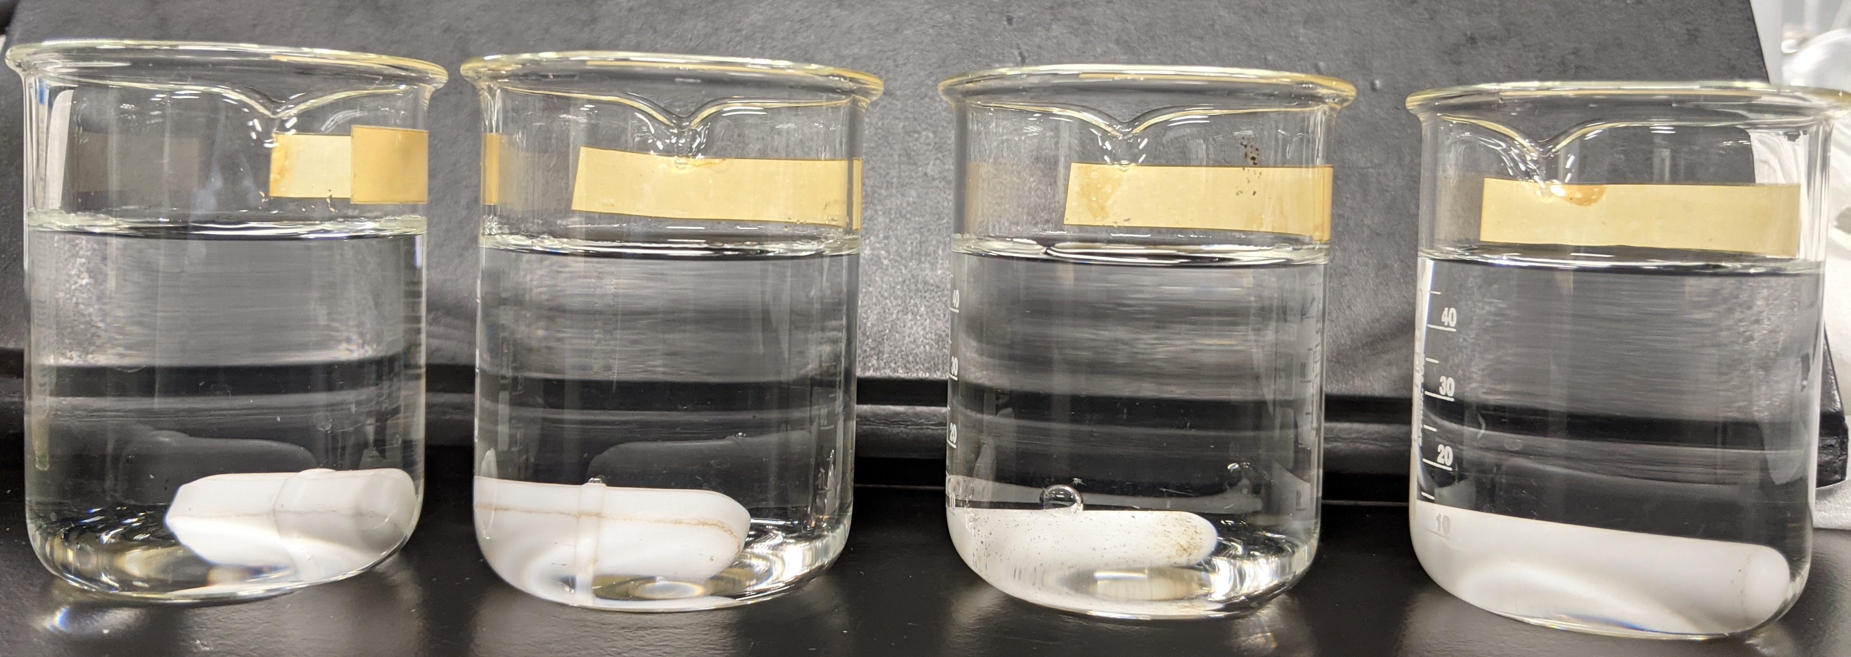
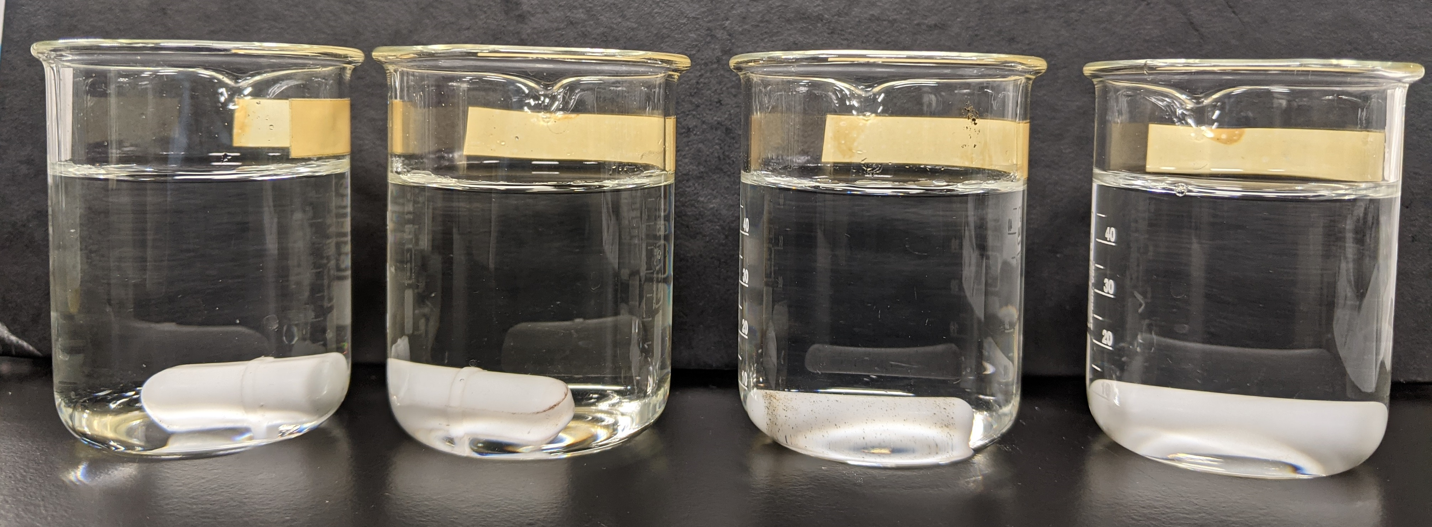
Action item 4: Anti-scalant compatibility test - NF filtration of HFW+NH4F with IPA (with pH adjustment)
Initial solution pH: 3.3, pH adjusted to 3.5
Anti-scalant | pH | Solution appearance
AS1 | 3.0 | Clear
AS2 | 7.19 | Clear
AS3 | 3.7 | Clear
AS4 | 3.58 | Clear
AS4 was selected for the NF filtration experiment because its addition into the feed solution didn’t alter the solution pH much.

Slide 15
Action item 4: Result of NF filtration of HFW+NH4F with IPA (with pH adjustment)
Elements | Concentration for synthetic feed (ppm) | Concentrated feed (ppm) | Permeate (ppm)
pH | 3.5 | 5.04 | 3.29
Conductivity | 3,357 µS/cm | 9,022 µS/cm | 708.6 µS/cm
TDS | 1,134 | 4,921 | 344.4
NH4 | 19.7 | 50.1 | 12.2
F | 819 | 1,555 | 144
SO4 | 100 | 389 | 3.83
PO4 | 214 | 637 | 1.55
Cl | 54.3 | 178 | 21
Na | 721 | 2082 | 86
Ca | 1.49 | <0.1 | <0.1
Si | 12.7 | 73.9 | 51.9
COD | 2,450 | 3935 | 1580
TOC | 473 | 870 | 382
IPA | TBC | TBC | TBC

Slide 16
Action item 5: Preparation of Synthetic Combined NF RO Reject Solution (without pH adjustment)
Preferred chemicals | Required quantity for 1 Liter solution (gram)
NH4Cl | 0.209
NaCl | 0.011
CaCl2 | 0.049
HF | 2.242
H3PO4 | 0.367
SiH2O3 | 0.128
H2SO4 | 0.362
Elements | Desired concentration (ppm) | Calculated concentration based on added chemicals (ppm) | Concentration based on in-house measurement (ppm)
pH | 1.9 | - | 3
Conductivity | - | - | 7745 µS/cm
TDS | - | - | 4175
NH4 | 70.6 | 70.6 | TBC
F | 2129 | 2129 | 2304
SO4 | 355 | 355 | TBC
PO4 | 356 | 356 | 389
Cl | 177 | 177 | TBC
Na | 17.6 | 4.49 | 7.74
Ca | 17.7 | 17.7 | 7.94
Si | 46.2 | 46.2 | 41.2

Slide 17
Action item 5: Jar testing of Synthetic Combined NF RO Reject (without pH adjustment)– Testing 4
Jar | Polymer added | Chemical's dosage | Supernatant turbidity (NTU)
1 | Flopam AN 934 SH | 6000 ppm lime + 500 ppm CaCl2 | 9.98
2 | Flopam AN 934 SH | 6000 lime + 4000 ppm CaCl2 | 20.4
Elements | Concentration based on in-house measurement (ppm) | Supernatant quality for Jar 1 | Supernatant quality for Jar 2
pH | 3 | 9.68 | 9.29
Conductivity | 7745 | 1941 µS/cm | 7256 µS/cm
TDS | 4175 | 974.7 | 3889
F | 2304 | 22 | 7.51
SO4 | TBC | 150 | 137
PO4 | 389 | <1 | <1
Na | 7.74 | 8.2 | 25.4
Ca | 7.94 | 295 | 1290
Si | 41.2 | 14.9 | 5.66

Slide 18
Action item 5: Preparation of Synthetic HFW+NH4F with IPA (without pH adjustment)
Preferred chemicals | Required quantity for 1 Liter solution (gram)
NH4Cl | 0.059
NaCl | 0.013
CaCl2 | 0.014
HF | 0.843
H3PO4 | 0.206
SiH2O3 | 0.039
H2SO4 | 0.102
IPA | 1
Elements | Desired concentration (ppm) | Calculated concentration based on added chemicals (ppm) | Concentration based on in-house measurement (ppm)
pH | - | - | 2.92
Conductivity | - | - | 3371 µS/cm
TDS | - | - | 1741
NH4 | 20 | 20 | TBC
F | 800 | 800 | 802
SO4 | 100 | 100 | TBC
PO4 | 200 | 200 | 161
Cl | 50 | 55.86 | TBC
Na | 5 | 5 | 10.1
Ca | 5 | 5 | 4.6
Si | 14.02 | 14.02 | 9.15
COD | - | - | 2523
TOC | - | - | 588
IPA | 1,000 | 1,000 | TBC

Slide 19
Action item 5: Results of NF filtration of HFW+NH4F with IPA (without pH adjustment)
Elements | Concentration for synthetic feed (ppm) | NF concentrated feed (ppm) | NF Permeate (ppm)
pH | 2.92 | 2.08 | 2.26
Conductivity | 3371 µS/cm | 4821 µS/cm | 3071 µS/cm
TDS | 1741 | 2535 | 1580
F | 802 | 1328 | 456
SO4 | TBC | 201 | 88.9
PO4 | 161 | 203 | 150
Cl | TBC | 152 | 147
Na | 10.1 | 30.9 | 4.72
Ca | 4.6 | 21.5 | 0.105
Si | 9.15 | 41.5 | 4.19
COD | 2523 | 2970 | 2013
TOC | 588 | 691 | 484

Slide 20
Conclusions
Following conclusions are made based on several RO/NF projections, bench scale testing and PHREEQC models
UF, NF and SWRO will be sufficient for generating required water quality for cooling tower and local scrubbers. Recovery ratio between 55-60%.
Lower pH will be helpful to get higher membrane rejections. No scaling issues with lower Ph. Conventional membranes can be used for pH between 2-12, specialty membranes may be required for lower Ph.
Mixed/NF +SWRO reject for removal of Fluoride (by coagulation, flocculation, clarification, sedimentation, filter press) looks a suitable configuration.
Lime and CaCl2 combination or higher amount of lime will be enough for the removal of fluoride to meet the discharge water quality.
Sludge will contain more than 80% of CaF2. if in case phosphates are higher, then sludge quality will differ. XRD results shows the major peak is CaF2.
NF will be having tolerance to the organics. Experiments are on going to validate the % IPA rejections.
Optimization of chemical dosage/conditions can be done during detailed engineering design

Slide 21
Back up

